Slide 1
CpE111
Introduction to Computer Engineering
Dr. Minsu Choi
CH 8: Memory Elements & Arrays

Slide 2
Definition
A memory element is a circuit that can hold the value of a binary variable as required by the system.
3 modes: write, hold and read.

Slide 3
Memory Types
RAM (Random Access Memory): read/write can be done. Loose contents when the power supply is disconnected.
ROM (Read-Only Memory): Information is permanently stored. Only read operation can be done.
Variations:
  PROM (Programmable ROM) – write procedure requires a special electronics setup.
  Flash: holds contents even though the power supply is disconnected.
  Registers: commonly used for fast internal storage. Each resister can usually hold one word.

Slide 4
Latches
A latch is a logic element that can follow data variations and transfer these changes to an output line.
It is transparent in that the output Q(z) follows changes at the input at least part of the time.
The storage is achieved using a bi-stable circuit, in which either Q=0 or Q=1 can be held in the cell.

Slide 5
SR Latch (Set-Reset Latch)
A transparent bi-stable element that is sensitive to changes in the inputs.
Set (S) operation: the output is forced to a value of Q = 1.
Reset (R) operation: the output is forced to a value of Q = 0.
There are two different ways to implement: NOR-based and NAND-based.

Slide 6
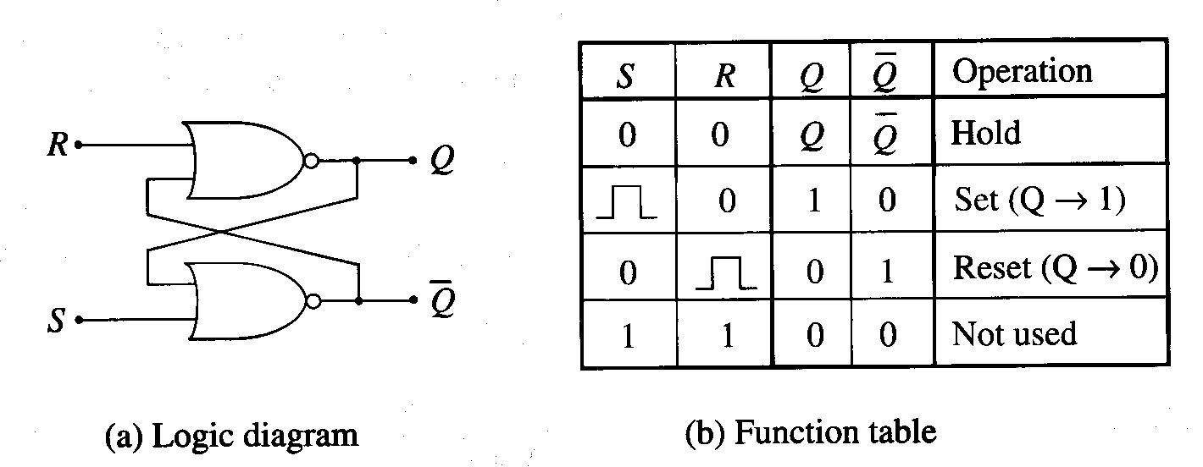
NOR-Based SR Latch Implementation
Two cross-coupled NOR gates used.
Feedback interconnects used to retain stored logic value.
0 to 1 to 0 transition at S sets Q.
0 to 1 to 0 transition at R resets Q.
S=0 and R=0 to hold the current value of Q.
S=1 and R=1 case is not used.

Slide 7
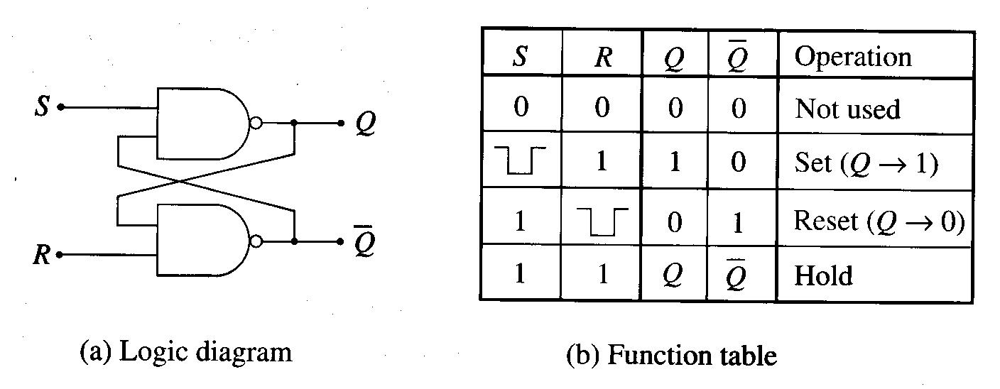
NAND-Based SR Latch Implementation
Two cross-coupled NAND gates used.
Feedback interconnects used to retain stored logic value.
1 to 0 to 1 transition at S sets Q.
1 to 0 to 1 transition at R resets Q.
S=1 and R=1 to hold the current value of Q.
S=0 and R=0 case is not used.

Slide 8
D Latch
Input D determines Q and /Q.
An inverter can be added to the NOR-based SR latch to implement a D latch.

Slide 9
Clocks and Synchronization
A clock is a control signal that periodically makes a transition from 0 to 1 then back to 0.
It repeats same transition every T seconds.
Recall f = 1/T and T = 1/f.
Ex)

Slide 10
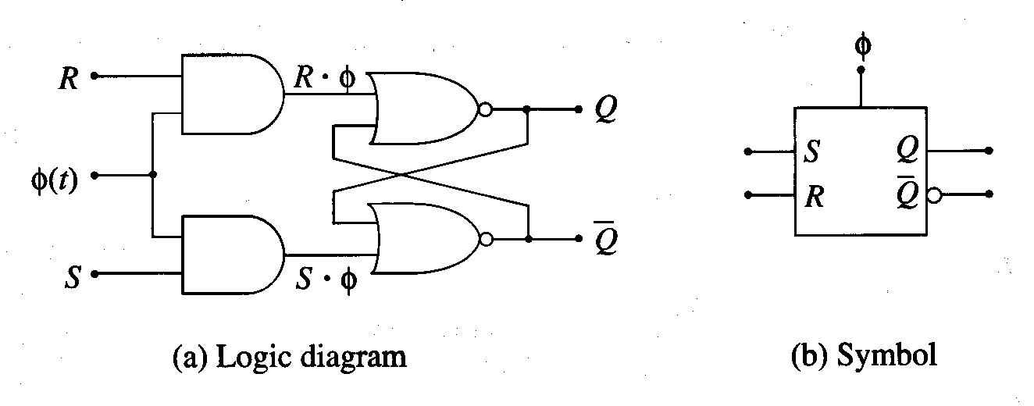
Clocked SR Latch
If Φ=0, then S Φ=0 & R Φ=0. So, the latch is in the hold state.
If Φ=1, then set/reset operations can be done by S and R.
This defines a “level triggered” or “level-sensitive” latch.

Slide 11
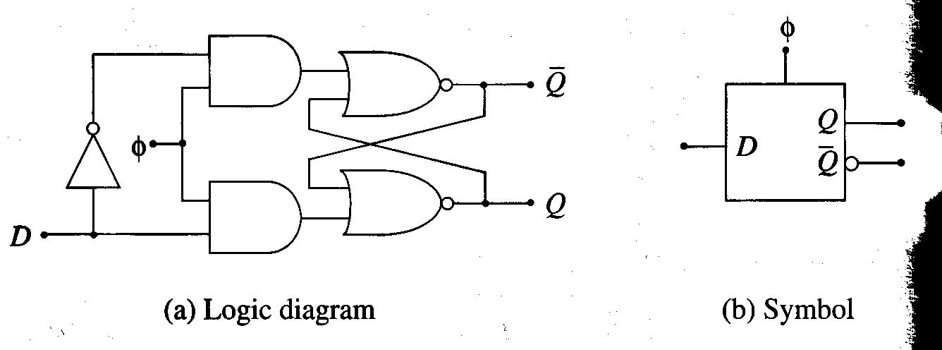
Clocked D Latch
The input D is active only when Φ=1.
If Φ=0, then it is in hold state.

Slide 12
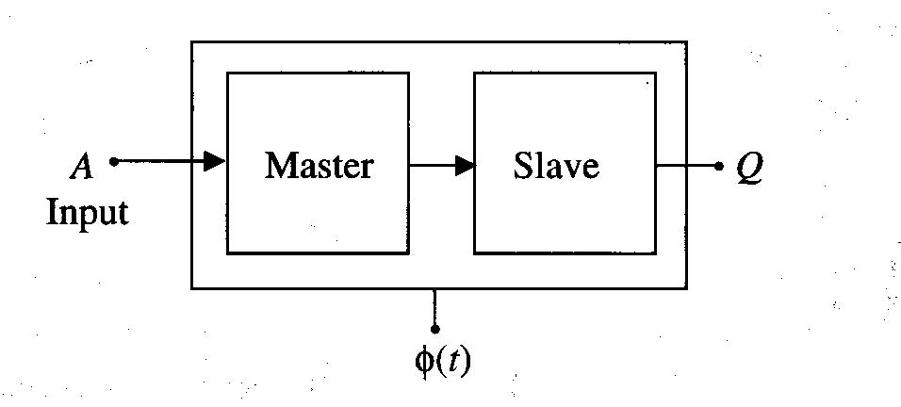
Master-Slave and Edge-Triggered Flip-Flops
A flip-flop is non-transparent latch that is controlled by the clock.
Master-slave structure is shown below.

Slide 13
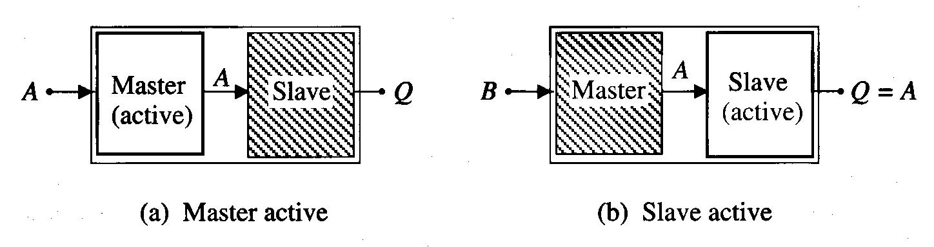
Why Master-Slave Structure Makes It “Non-Transparent”?
Fig (a): The input to the master circuit is activated and the value of A is stored there. During the time, the slave is inactive (hold state) and cannot accept input.
Fig (b): Then, the master is placed in a hold state while the slave is active. The value of A (not B!) is then accepted by the slave and is available at the output of the flip-flop giving Q=A.
So, it is non-transparent (current output is not determined by the current input).

Slide 14
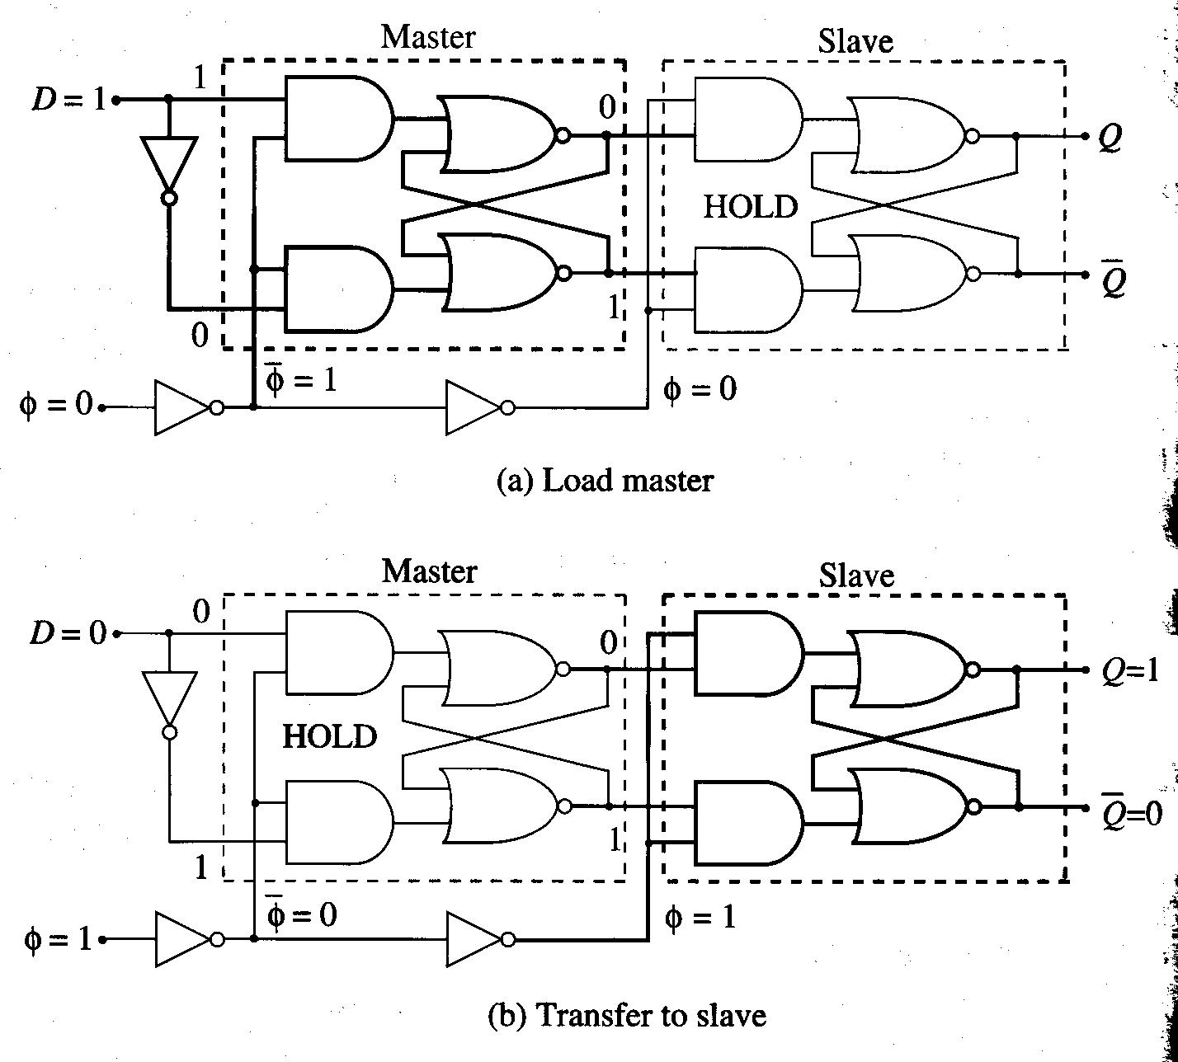
Master-Slave D-Type Flip-Flop (DFF)

Slide 15
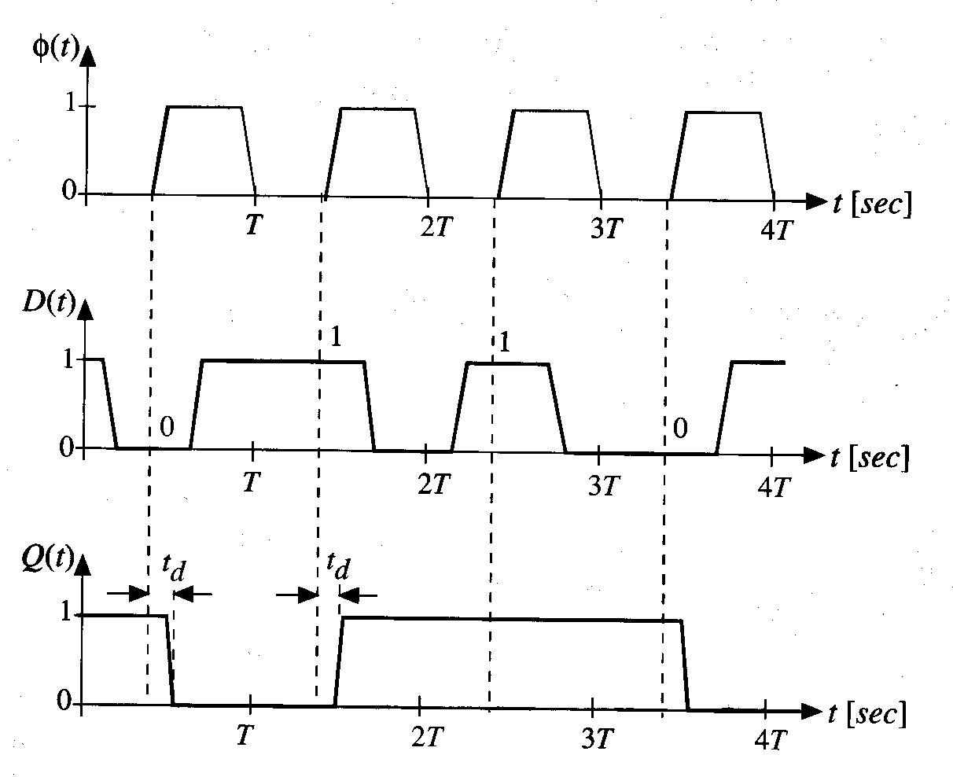
Timing Diagram
The value that is transferred to the slave circuit is the value that is in the master latch when the clock makes a transition from 0 to 1.
So, DFF is “edge-sensitive”.

Slide 16
Edge-Triggered
Similar to edge-sensitive. However, it allows input data D to be loaded only when the clock is making a transition.
The output Q is simply the value of input D delayed by one clock cycle -> Q(t+T)=D(t).
The delay (=T) is an important aspect since we can store the present value for use during the next clock cycle.
Then, how can we store a data bit for several clock cycles? => we must route the output Q back to the input D.

Slide 17
DFF with Feedback Loop
If LD=0, then holds the present value.
If LD=1, then new value D is routed to the DFF storage element.
Then, how to reset the flip-flop? (force Q to 0)

Slide 18
DFF with Reset
If RESET=0, D=d at the input.
If RESET=1, forces D=0 at the input.

Slide 19
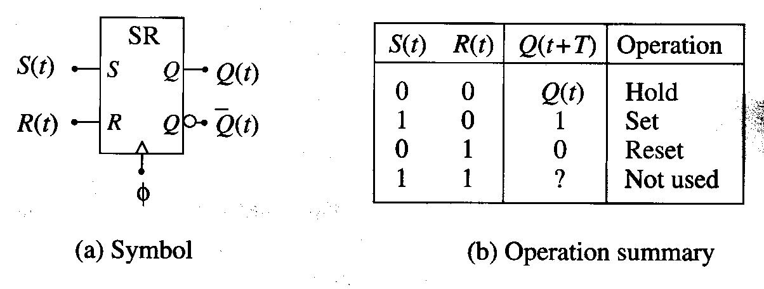
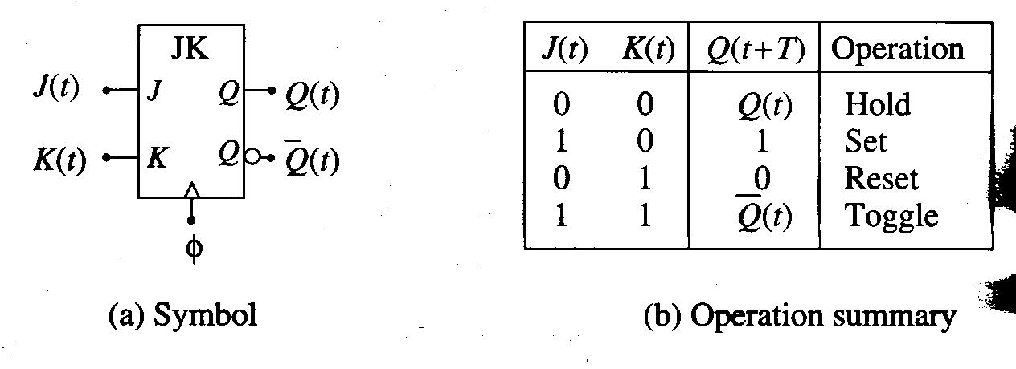
Other Types of Flip-Flops

Slide 20
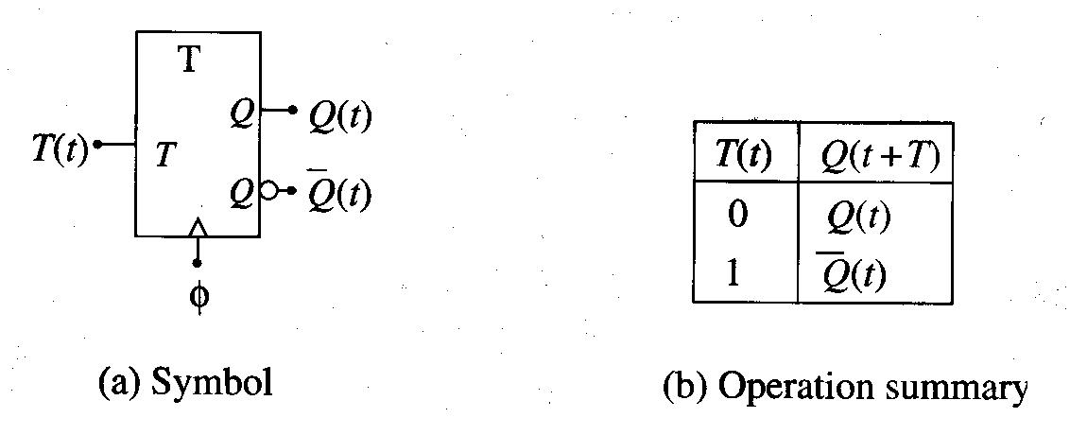
Continued,

Slide 21
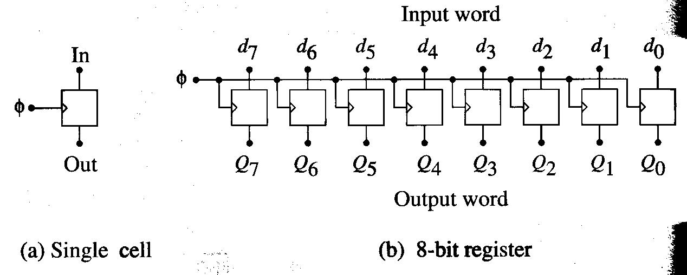
Registers
A storage for n-bit binary word.
Single-bit cells are cascaded to build multi-bit register.
Mostly edge-triggered. Other control signals (e.g., LD) are not shown explicitly.
Register symbol:

Slide 22
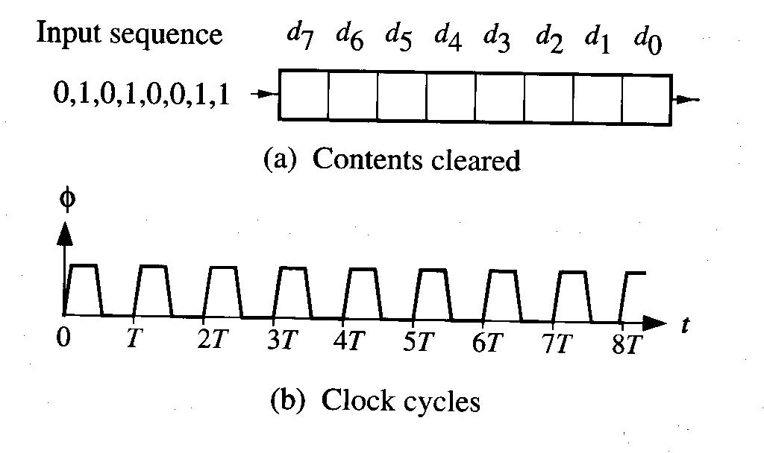
Shift Registers
Designed to move bits to neighboring cells as the clock pulses are applied.
Ex)

Slide 23
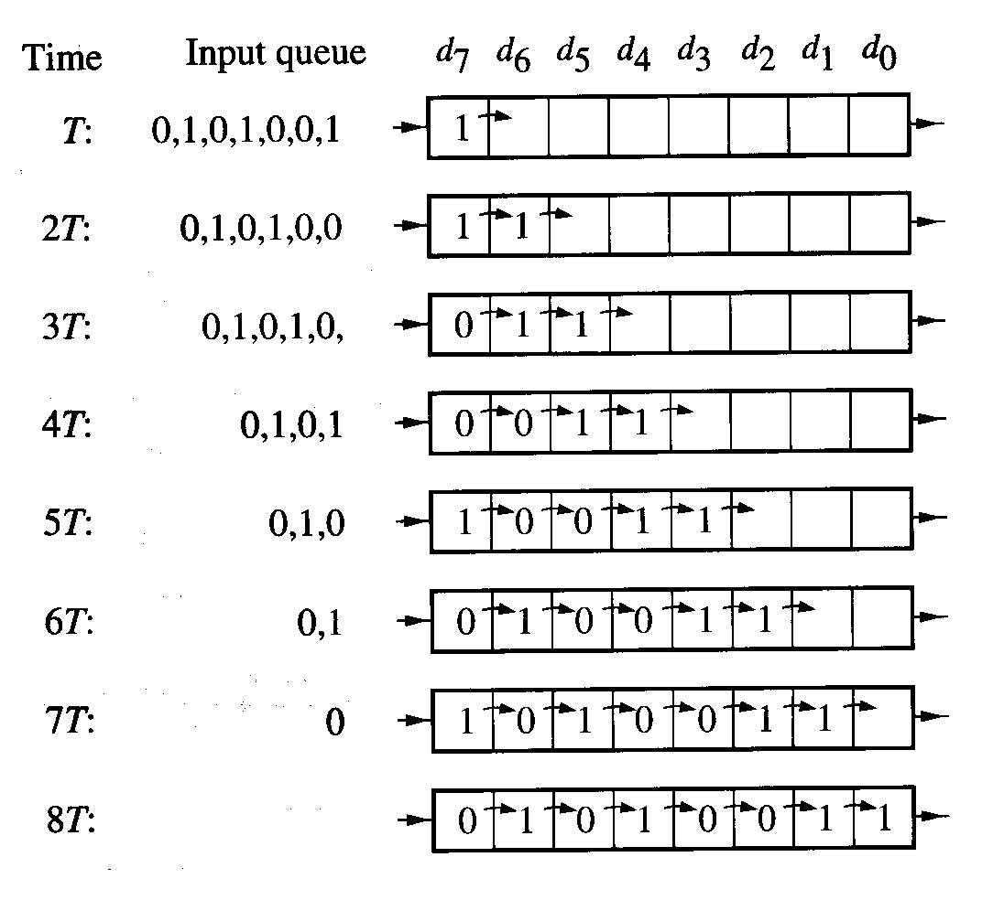
Continued,

Slide 24
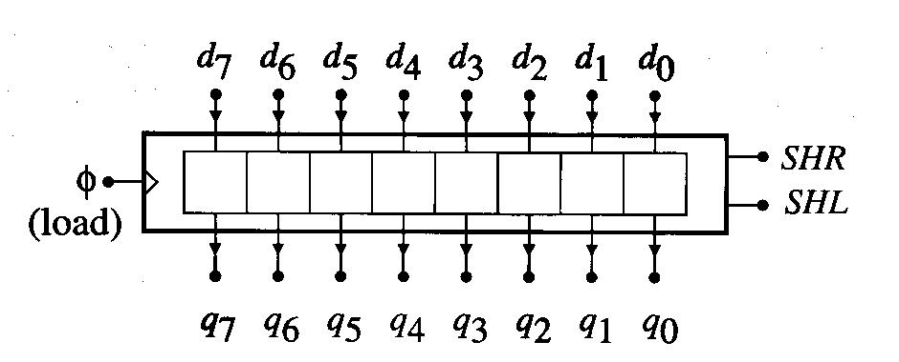
Shift Register w/ Parallel Load Capability
8-bit data word can be loaded/ accessed at the same time.
SHR (shift right) & SHL (shift left) control signals are used to shift contents.

Slide 25
Example
N=00011100

Slide 26
Rotation Operations
ROR (Rotation Right) and ROL (Rotation Left): Rotation does not lose a bit if it is shifted out, but transfers it to the other side.
Ex) N=10101100

Slide 27
Random Access Memory (RAM)
Commonly found as the main system memory in a desktop computer unit.
It provides the ability to store all of the important data needed to run the computer such as programs and the OS.
There are two major types:
  SRAM (Static RAM) for faster operation, but expensive.
  DRAM (Dynamic RAM): cheap, large but slow.

Slide 28
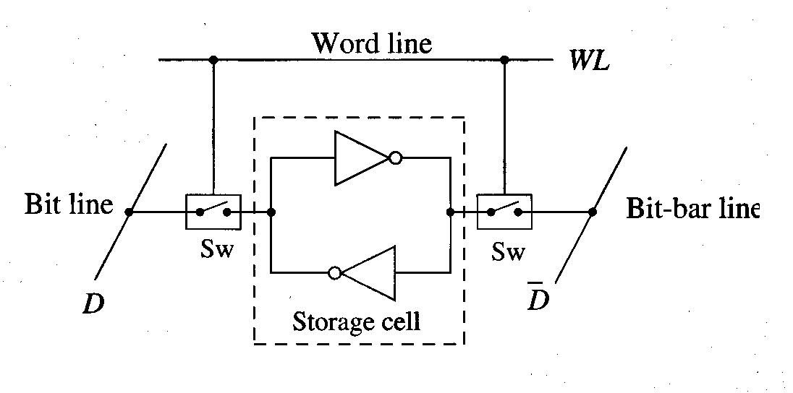
SRAM
Closed loop cascaded inverters can be used to build a SRAM cell.
If WL=0, hold state (SWs open).
If WL=1, read & write ops possible (SWs closed).

Slide 29
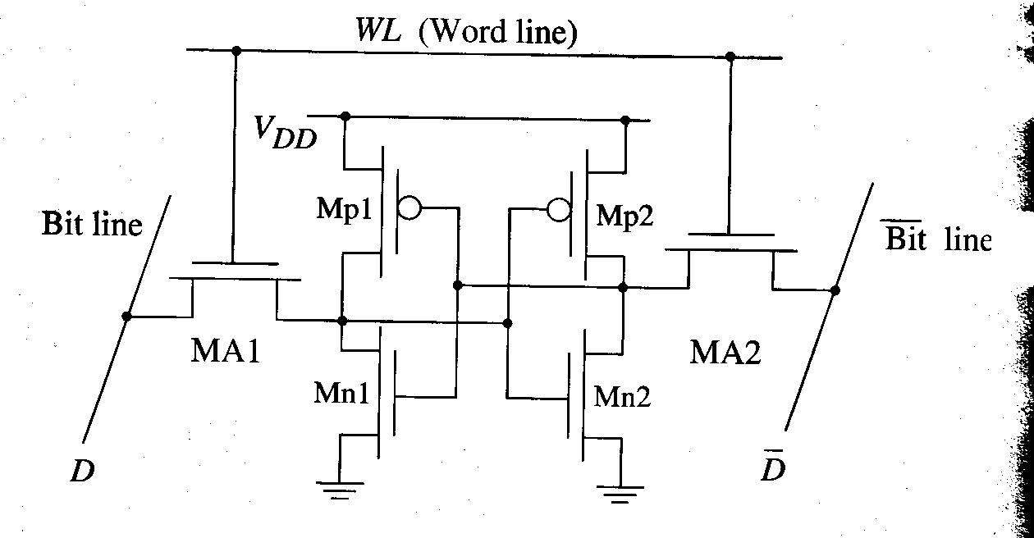
CMOS Implementation
Two cross-coupled CMOS inverters used.
Two nFET used as switches.

Slide 30
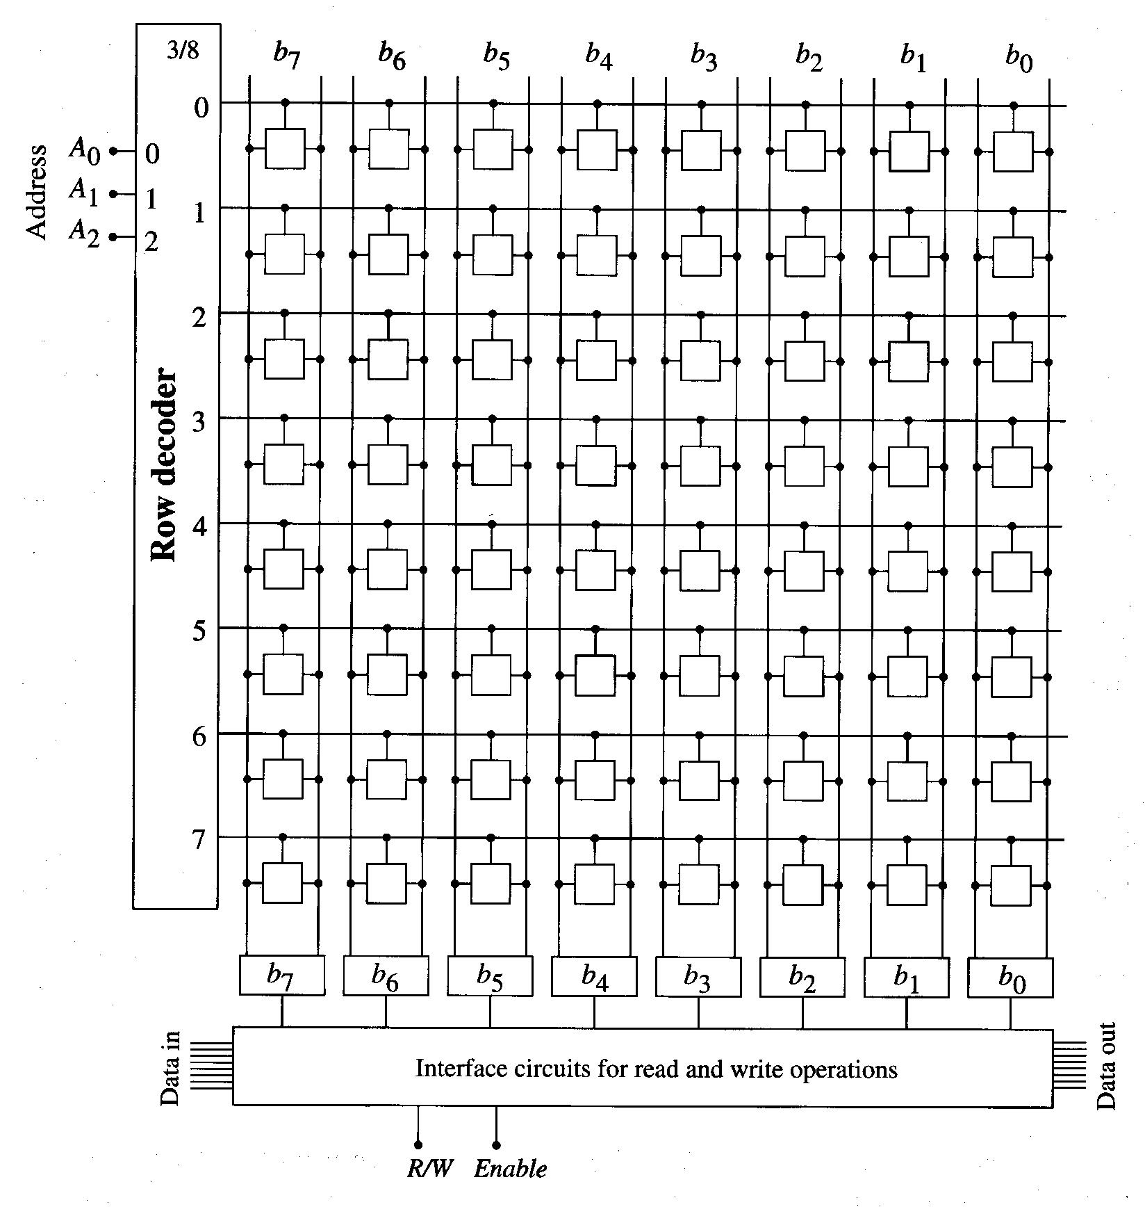
M X N SRAM Array

Slide 31
Continued,
Row decoder is 3/8 active-high decoder to select desired row.
3-bit word, A₂A₁A₀, is used to select -> called “address”.
It specifies the location of a particular word in memory.
Ex) Larger SRAM array

Slide 32
Parity & Error Detection Codes
Even a single bit error can cause an entire program to crash -> reliability is critical.
EDC (Error Detection Code) & ECC (Error-Correction Code) are used.
Ex) Parity bit (the most simple EDC)
Parity bit generator

Slide 33
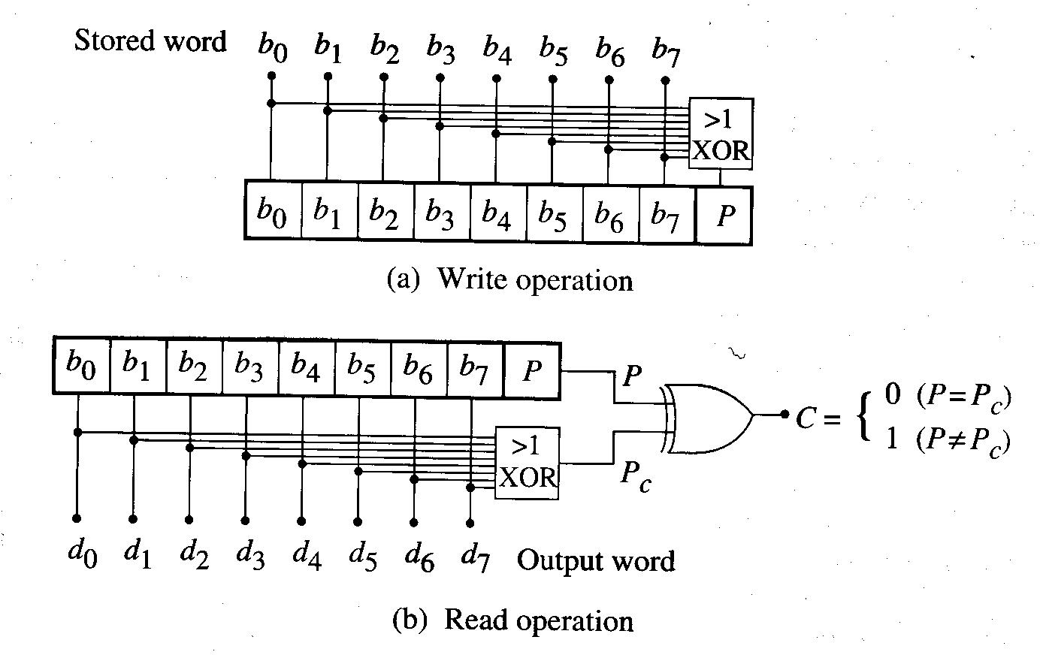
Parity Bit Generation and Checking

Slide 34
ROM (Read-Only Memory)
Memory array that used for permanent data storage (=non-volatile) => data remains even if the power supply is disconnected.
Ex) 64x8b ROM
The address word A₅A₄A₃A₂A₁A₀ is sent to a row decoder.
The data word is send to the output circuits, which are activated by the Enable control.

Slide 35
DRAM (Dynamic RAM)
Can be built with much higher densities than SRAM cells.
The descriptive adjective “Dynamic” reflects the fact that the contents of a cell will change in time during the hold state.
DRAM cell is slower than SRAM cell. However, the cost per bit is much lower than SRAM cell -> attractive in system design where large arrays are required.
Since many companies use their most advanced technology for making DRAMs, it is called “technology driver”.

Slide 36
DRAM Operation Detail: Write Operation
When WL=1, the nFET acts as a closed switch allowing write or read operation.
To write to the cell:
  Data voltage V_{D} is applied to the data line D.
  The resulting current charges the storage capacitor C_{S} to the voltage level V_{S}.
  The value of the stored bit is defined by the charge, ____________, on the capacitor.
  If V_{S} = V₀ = 0v, then Q_{S} = 0 corresponding to a logic ‘0’ value. If V_{S} = V₁, then a logic 1 charge. Q_{S} = C_{S} x V₁ is stored on the capacitor.

Slide 37
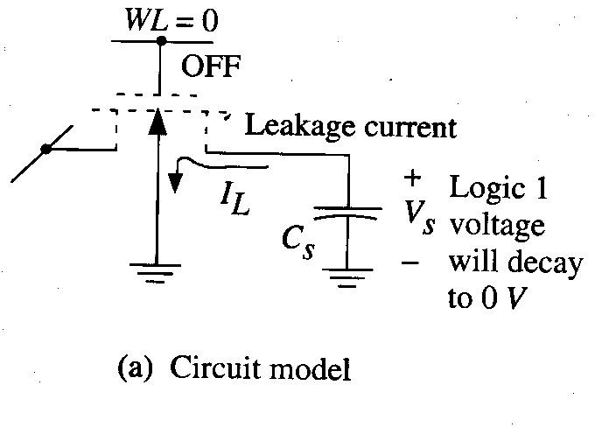
DRAM: Hold Operation
WL=0 for hold operation.
The charge Q_{S} would be held, since nFET is open.
However, nFET cannot block all of the current flow.
Even with a zero gate voltage, nFET admit a small “leakage current” I_{L} that removes charge from the capacitor -> the charge Q_{S} cannot be stored indefinitely -> logic 1 voltage will decay to 0v (logic 0) over the time.

Slide 38
Hold Time Estimation
Suppose that we place a logic 1 voltage V_{S} = V₁ on the capacitor, and we wish to calculate the time that the voltage can be held on the cell when the nFET is open, so that we can refresh the stored logic 1 to keep it.

Slide 39
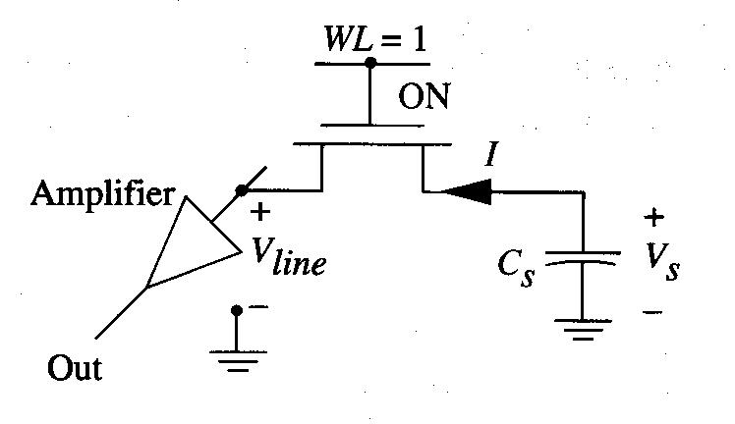
Read & Refresh Operations
WL=1 to turn on the nFET, which allows the current to flow to the bit line.
Then, amp provides strengthened signal to output.
In case of hold op, periodical read-out, amplification and rewrite needed -> called refresh.
Say the max hold time is 10^-3sec. Then, the min refresh frequency is:

Slide 40
Program Completed
University of Missouri-Rolla
© 2003 Curators of University of Missouri

